Slide 1
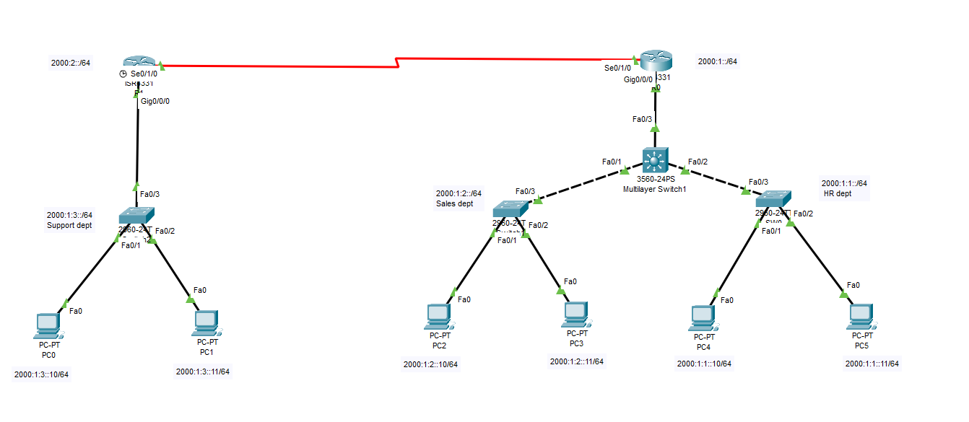

IPv6 Interface Configuration
interface GigabitEthernet0/0
ipv6 address 2001:db8:1::1/64
no shutdown
interface GigabitEthernet0/1
ipv6 address 2001:db8:2::1/64
no shutdown

Slide 3
Enable IPv6 Routing
IPv6 Interface Configuration
interface GigabitEthernet0/0
ipv6 address 2001:db8:1::1/64
no shutdown
interface GigabitEthernet0/1
ipv6 address 2001:db8:2::1/64
no shutdown
Explanation: This configures IPv6 addresses on the router’s interfaces connected to different departments (Sales, HR, Support). The no shutdown command enables the interface. Each interface has a unique IPv6 subnet for proper routing and isolation.
ipv6 unicast-routing

Slide 4
OSPFv3 Configuration
Enable IPv6 Routing
ipv6 unicast-routing
Explanation: Enables the router to forward IPv6 packets. Without this, the router won’t route IPv6 traffic between interfaces.
interface GigabitEthernet0/0
ipv6 ospf 1 area 0
interface GigabitEthernet0/1
ipv6 ospf 1 area 0
ipv6 router ospf 1
router-id 1.1.1.1

Slide 5
OSPFv3 Configuration
SSH Configuration
interface GigabitEthernet0/0
ipv6 ospf 1 area 0
interface GigabitEthernet0/1
ipv6 ospf 1 area 0
ipv6 router ospf 1
router-id 1.1.1.1
Explanation: Configures OSPFv3, the IPv6 version of OSPF, which dynamically shares routing info between routers. The router-id uniquely identifies each router in the OSPF domain.
hostname R1
ip domain-name project.local
crypto key generate rsa
1024
username admin secret cisco123
line vty 0 4
transport input ssh
login local

Slide 6
ACL - Block Sales to HR
SSH Configuration
hostname R1
ip domain-name project.local
crypto key generate rsa
1024
username admin secret cisco123
line vty 0 4
transport input ssh
login local
ipv6 access-list BLOCK_SALES_TO_HR
deny ipv6 2001:db8:1::/64 2001:db8:2::/64
permit ipv6 any any
interface GigabitEthernet0/0
ipv6 traffic-filter BLOCK_SALES_TO_HR in

Slide 7
ACL - Block Sales to HR
interface FastEthernet0/1
switchport mode access
switchport port-security
switchport port-security maximum 1
switchport port-security mac-address sticky
switchport port-security violation restrict
ipv6 access-list BLOCK_SALES_TO_HR
deny ipv6 2001:db8:1::/64 2001:db8:2::/64
permit ipv6 any any
interface GigabitEthernet0/0
ipv6 traffic-filter BLOCK_SALES_TO_HR in
Port Security

Slide 8
ip dhcp snooping
ip dhcp snooping vlan 10,20,30
interface GigabitEthernet0/1
ip dhcp snooping trust
interface range GigabitEthernet0/2 - 24
ip dhcp snooping limit rate 10
Port Security
interface FastEthernet0/1
switchport mode access
switchport port-security
switchport port-security maximum 1
switchport port-security mac-address sticky
switchport port-security violation restrict
DHCP Snooping

Slide 9
vlan 10
name HR
vlan 20
name Sales
vlan 30
name Support
interface vlan 10
ip address 192.168.10.1 255.255.255.0
no shutdown
ip routing
DHCP Snooping
ip dhcp snooping
ip dhcp snooping vlan 10,20,30
interface GigabitEthernet0/1
ip dhcp snooping trust
interface range GigabitEthernet0/2 - 24
ip dhcp snooping limit rate 10
VLANs & Inter-VLAN Routing

Slide 10
Trunk Port Configuration
VLANs & Inter-VLAN Routing
vlan 10
name HR
vlan 20
name Sales
vlan 30
name Support
interface vlan 10
ip address 192.168.10.1 255.255.255.0
no shutdown
ip routing
interface GigabitEthernet0/1
switchport trunk encapsulation dot1q
switchport mode trunk

Slide 11
Trunk Port Configuration
VPN Tunnel (GRE)
interface GigabitEthernet0/1
switchport trunk encapsulation dot1q
switchport mode trunk
interface Tunnel0
ip address 10.10.10.1 255.255.255.0
tunnel source Serial0/0/0
tunnel destination [REMOTE_ROUTER_PUBLIC_IP]

Slide 12
ip arp inspection vlan 10,20,30
interface GigabitEthernet0/1
ip arp inspection trust
interface range GigabitEthernet0/2 - 24
ip arp inspection untrust
VPN Tunnel (GRE)
interface Tunnel0
ip address 10.10.10.1 255.255.255.0
tunnel source Serial0/0/0
tunnel destination [REMOTE_ROUTER_PUBLIC_IP]
ARP Inspection

Slide 13
Disable Unused Ports
ARP Inspection
ip arp inspection vlan 10,20,30
interface GigabitEthernet0/1
ip arp inspection trust
interface range GigabitEthernet0/2 - 24
ip arp inspection untrust
interface range FastEthernet0/10 - 24
shutdown

Slide 14
Disable Unused Ports
interface range FastEthernet0/10 - 24
shutdown

